Slide 1


DATA SCIENCE FOR
COVID-19
ARIADNA CUFFI TEIXIDO
April 2020

Slide 2


Content
Magnitude of the disease
Global Spread & European Spread
Age & Gender
Effect of Temperature / Humidity
Predictions
Impact on Economy
Conclusions

Slide 3








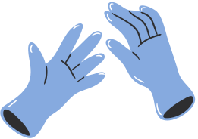
Magnitude of the disease
Is an outbreak of this magnitude unprecedented in modern history?

Slide 4
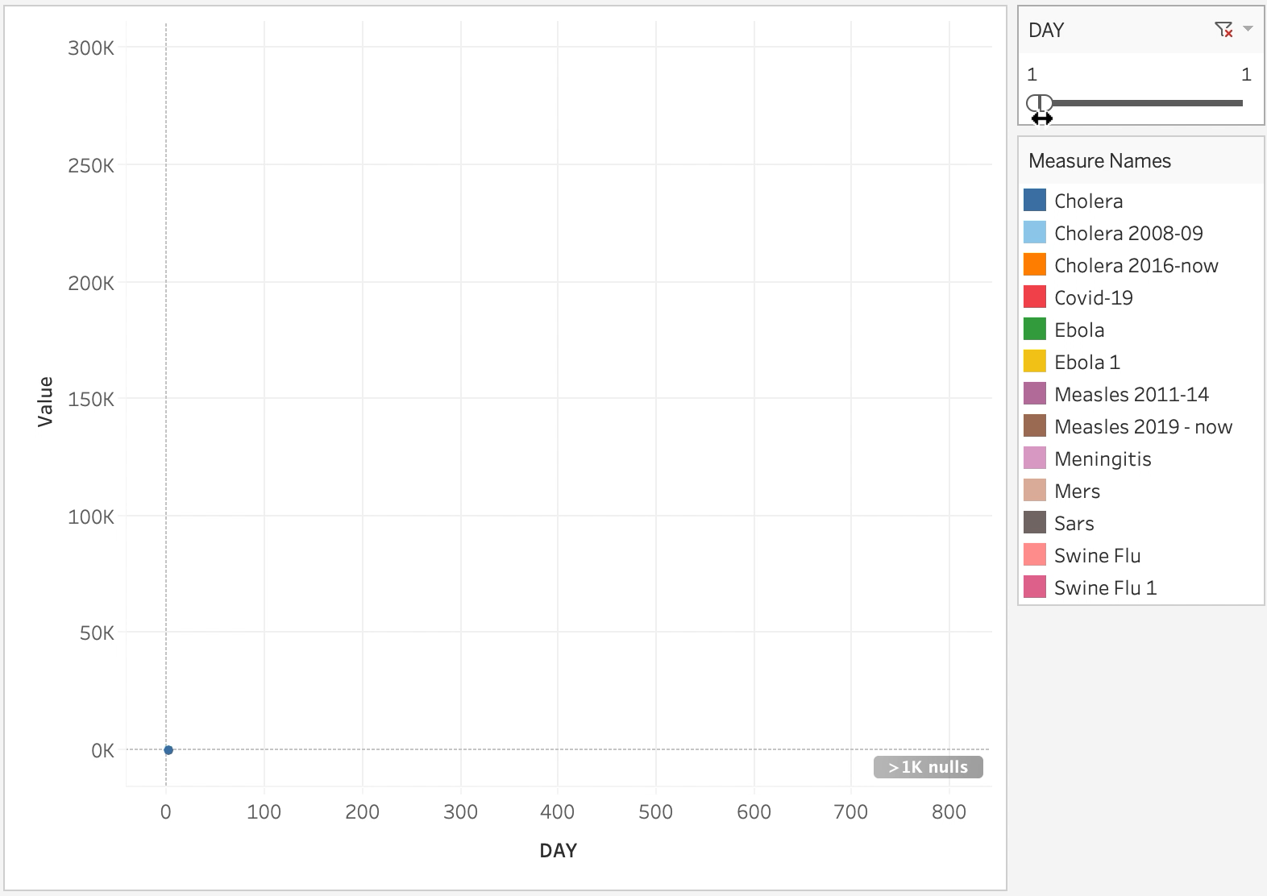
Comparison of COVID-19 with every other epidemic of this century.
Since 2000, there have been 12 outbreaks with over 500 deaths. (13 counting SARS).
Notes:
Since 2000, there have been 12 outbreaks with over 500 deaths. (13 if you count SARS). Let’s compare the death count of this COVID-19 epidemic with every other epidemic of this century.

Slide 5

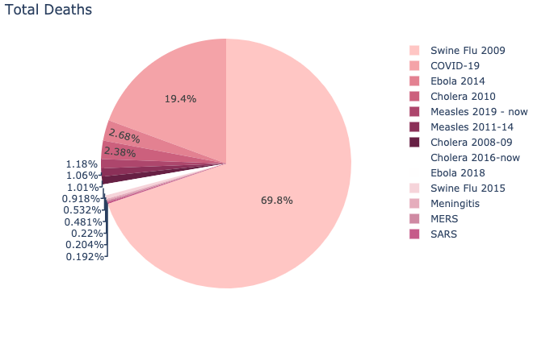
Lately people have been trying to minimize COVID-19 by comparing it to the Swine flu
Although it’s true that so far, Swine Flue has killed 4x more people.
Percentage of total Deaths globally
Notes:
To make things fair, we will shift each epidemic’s graph to alighn on Day 1 of the outbreak.

Slide 6
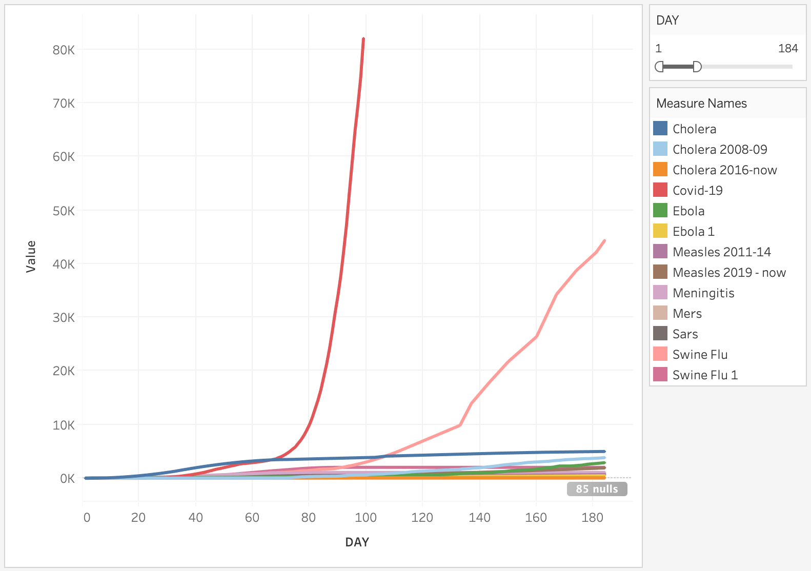
COVID-19 is the fastest-killing outbreak of the century, reaching 10K deaths 3 times faster

Slide 7
COVID-19 is the fastest-killing outbreak of the century, reaching 10K deaths 3 times faster

Slide 8
COVID-19 Global Spread
What was the evolution of the COV-19 spread?

Slide 9
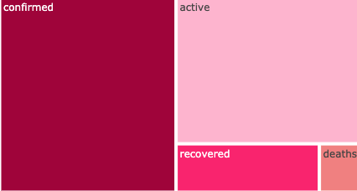
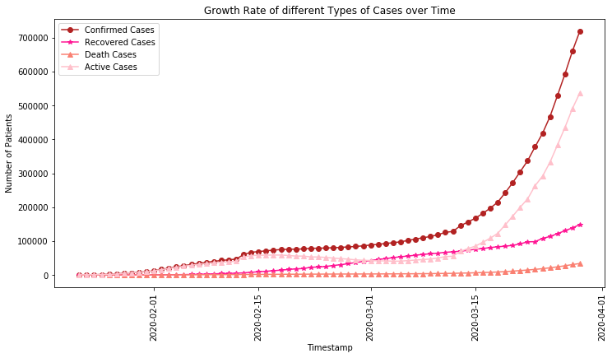
From the total confirmed cases, the 20% recovered and the 6% died, leaving 74% still active.
At the current rate, there are signs of a drop in the total cases.

Slide 10
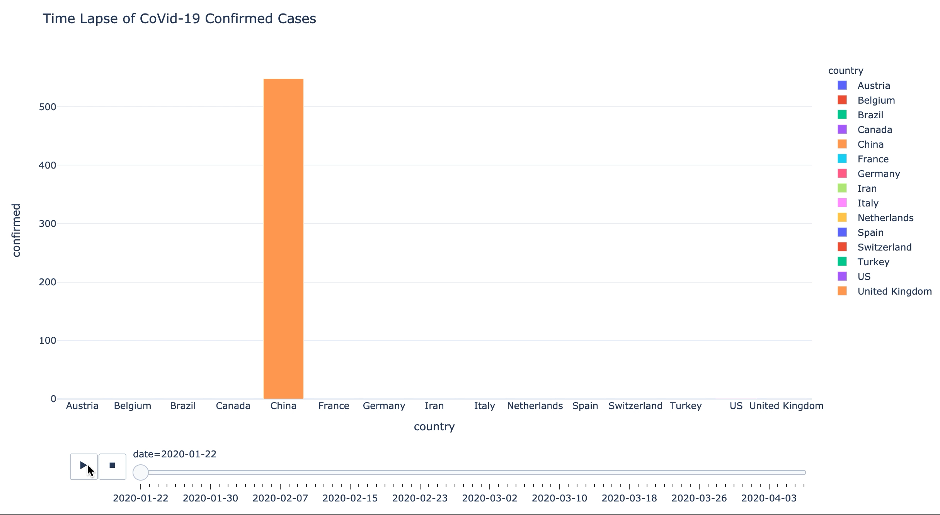
Although, China once had over 99% of the world’s active cases.
As of today,
US, Spain, Italy and other 2 countries have overtaken China in active cases.
Notes:
Although China once had over 99% of the world’s active cases. 7 out of 8 of tese cases have recovered.
US, Spain, Italy and other countries have overtaken China in active cases.

Slide 11
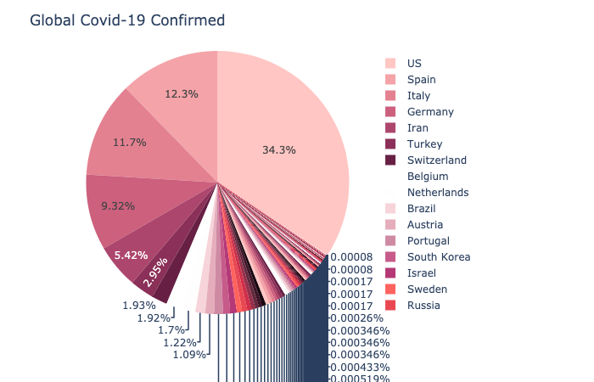
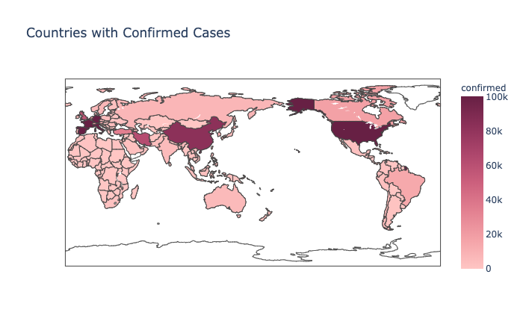
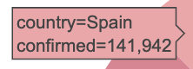
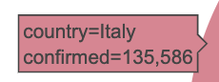
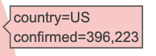
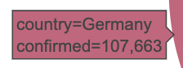
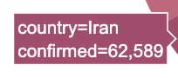
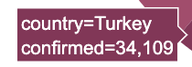
US is right now the country with more confirmed cases. 396,223 specifically, supposing 34.3% of the total cases.

Slide 12
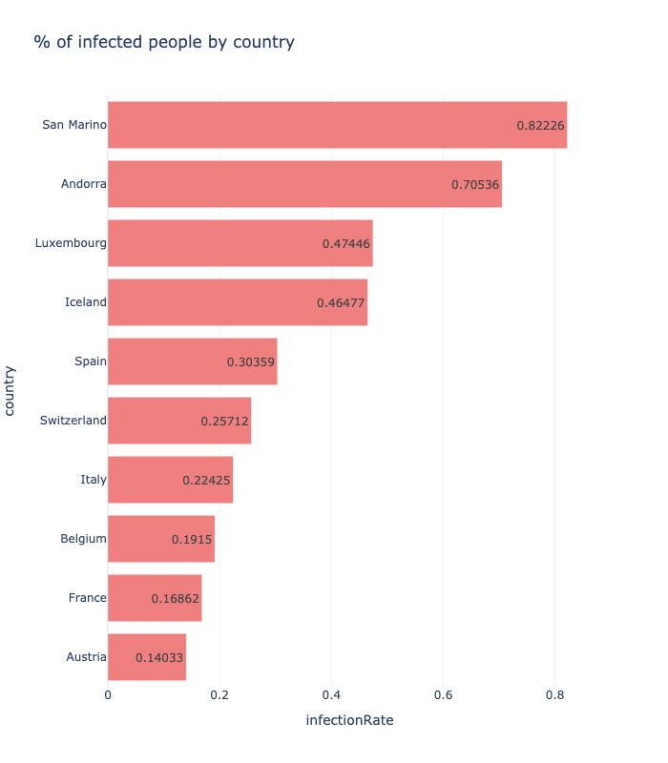
Considering the population, San Marino is the country with the highest percentage of cases / population.

Slide 13
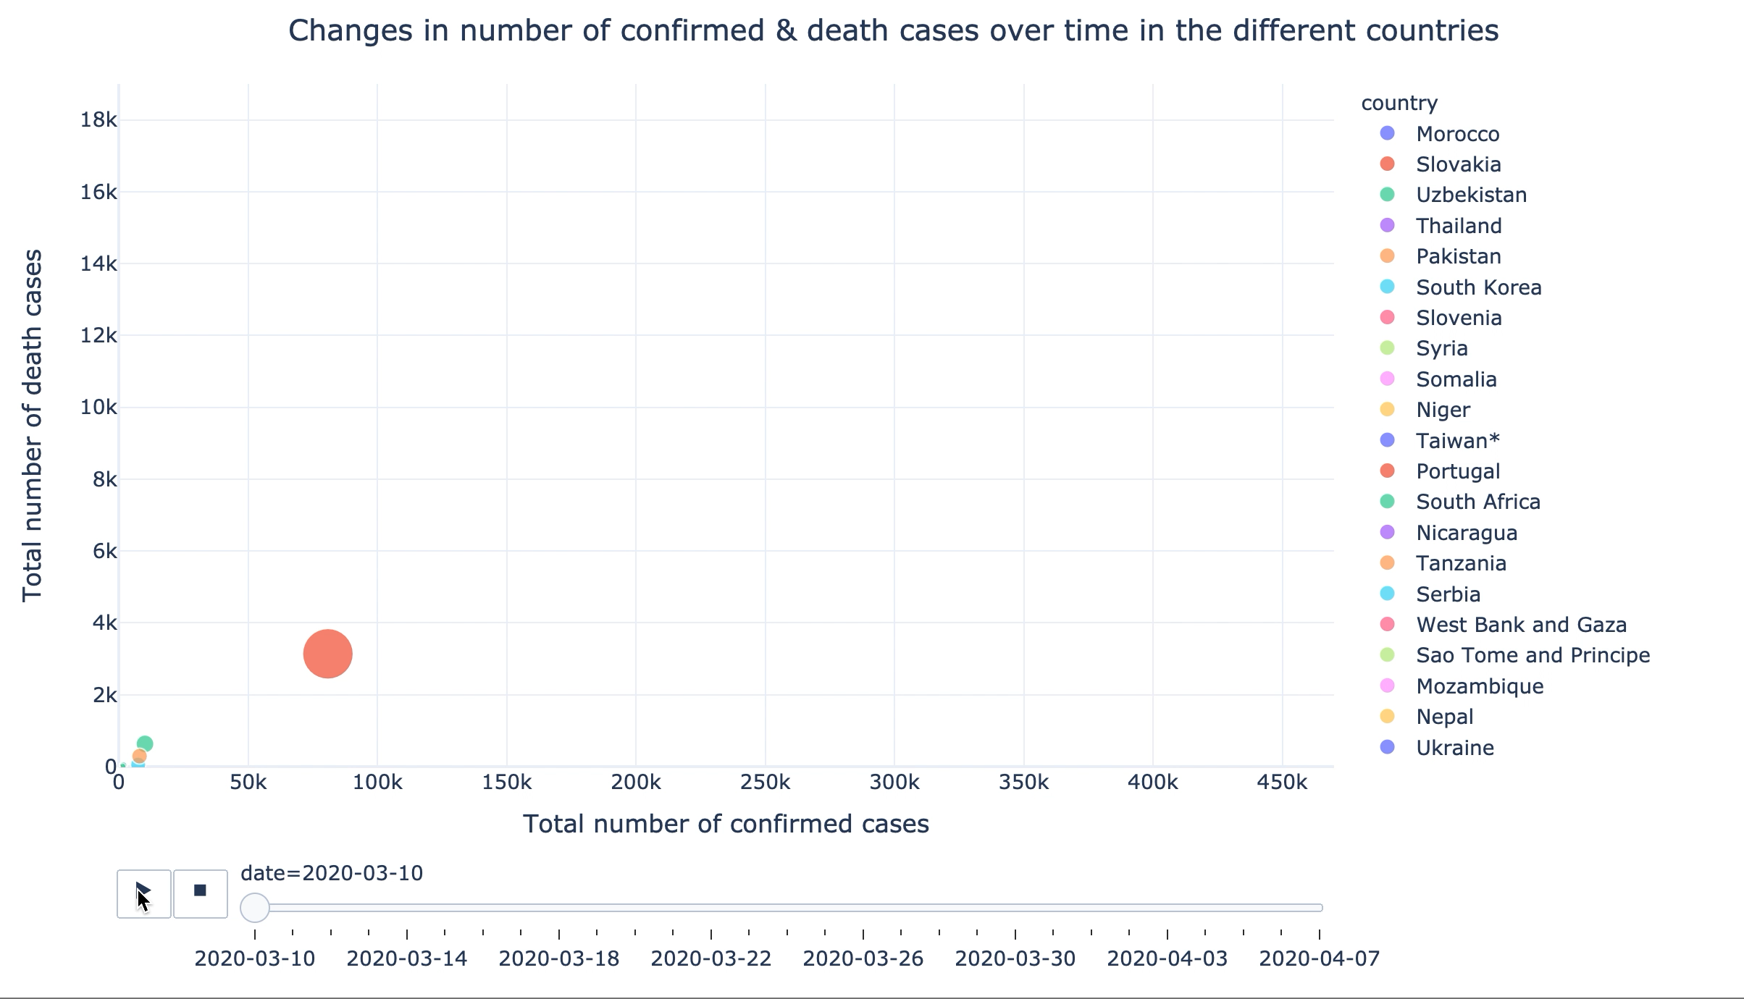
As per today, US may be leading the confirmed cases.
But Italy, followed by Spain are the countries with a greater number of deaths.

Slide 14
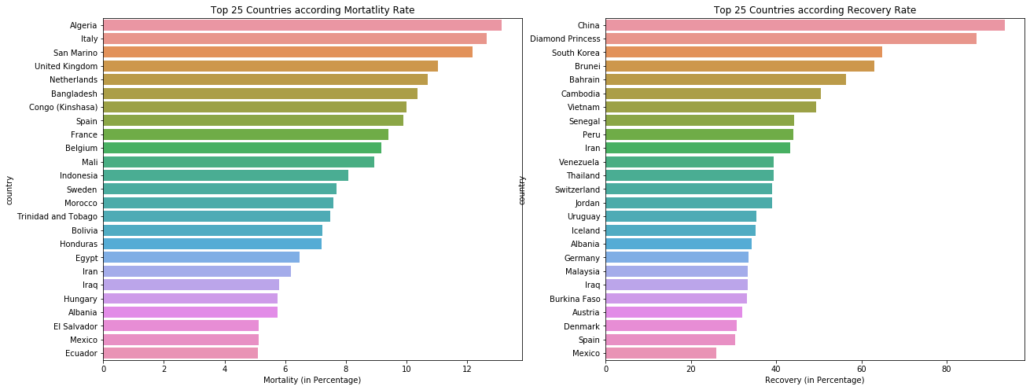
Even if Italy has the highest number of deaths, it’s Algeria the one having the highest Mortality Rate.
94% of the cases in China have recovered, being the country with the highest recovery rate.

Slide 15
European Spread
What was the evolution of the COVID-19 spread in Europe?

Slide 16
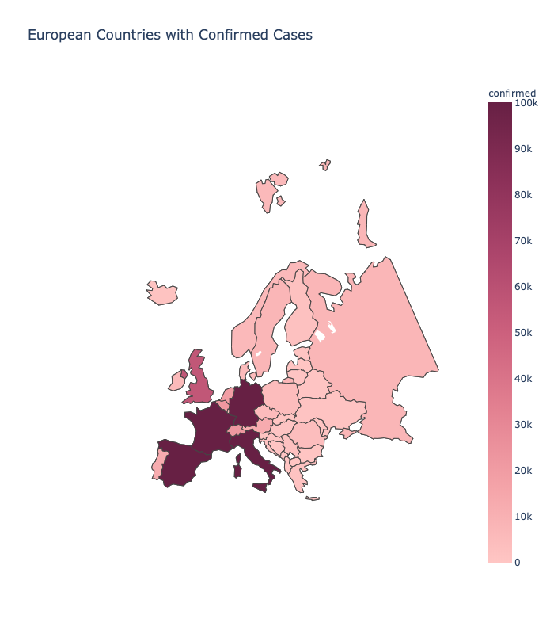
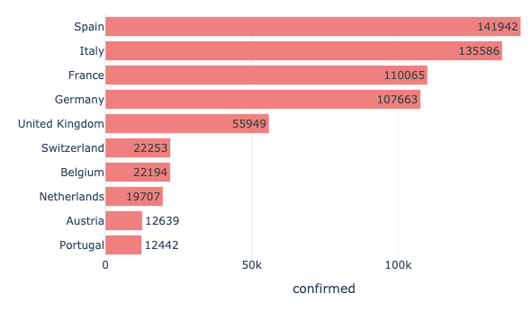
If we zoom in Europe, we see that Spain is the country with highest confirmed cases, followed by Italy.

Slide 17
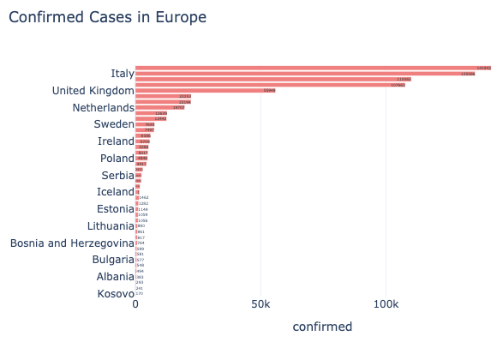
Kosovo is the country with least cases in Europe, 137 specifically.

Slide 18
Age & Gender
Is there any correlation between age and gender with COVID-19 deceases?

Slide 19
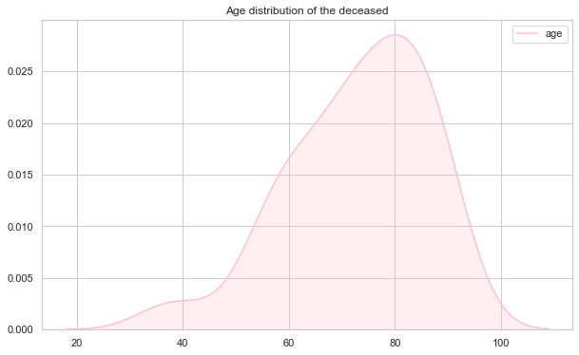
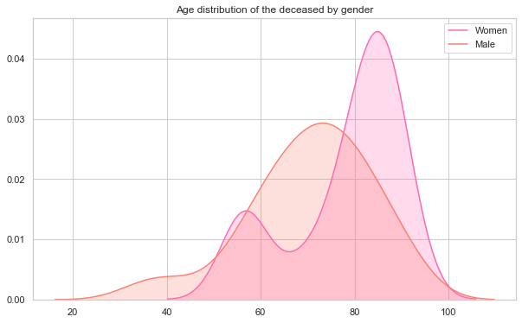
Cases in COVID-19 are happening in all the age groups. But the age group of 70 to 90 have a higher mortality rate.
Men are more likely to die from coronavirus than women.
Female deaths tend to be on elder ages.

Slide 20
Effect of Temperature/humidity
Is there any correlation between weather metrics and the spread of the number of infections/deaths?

Slide 21
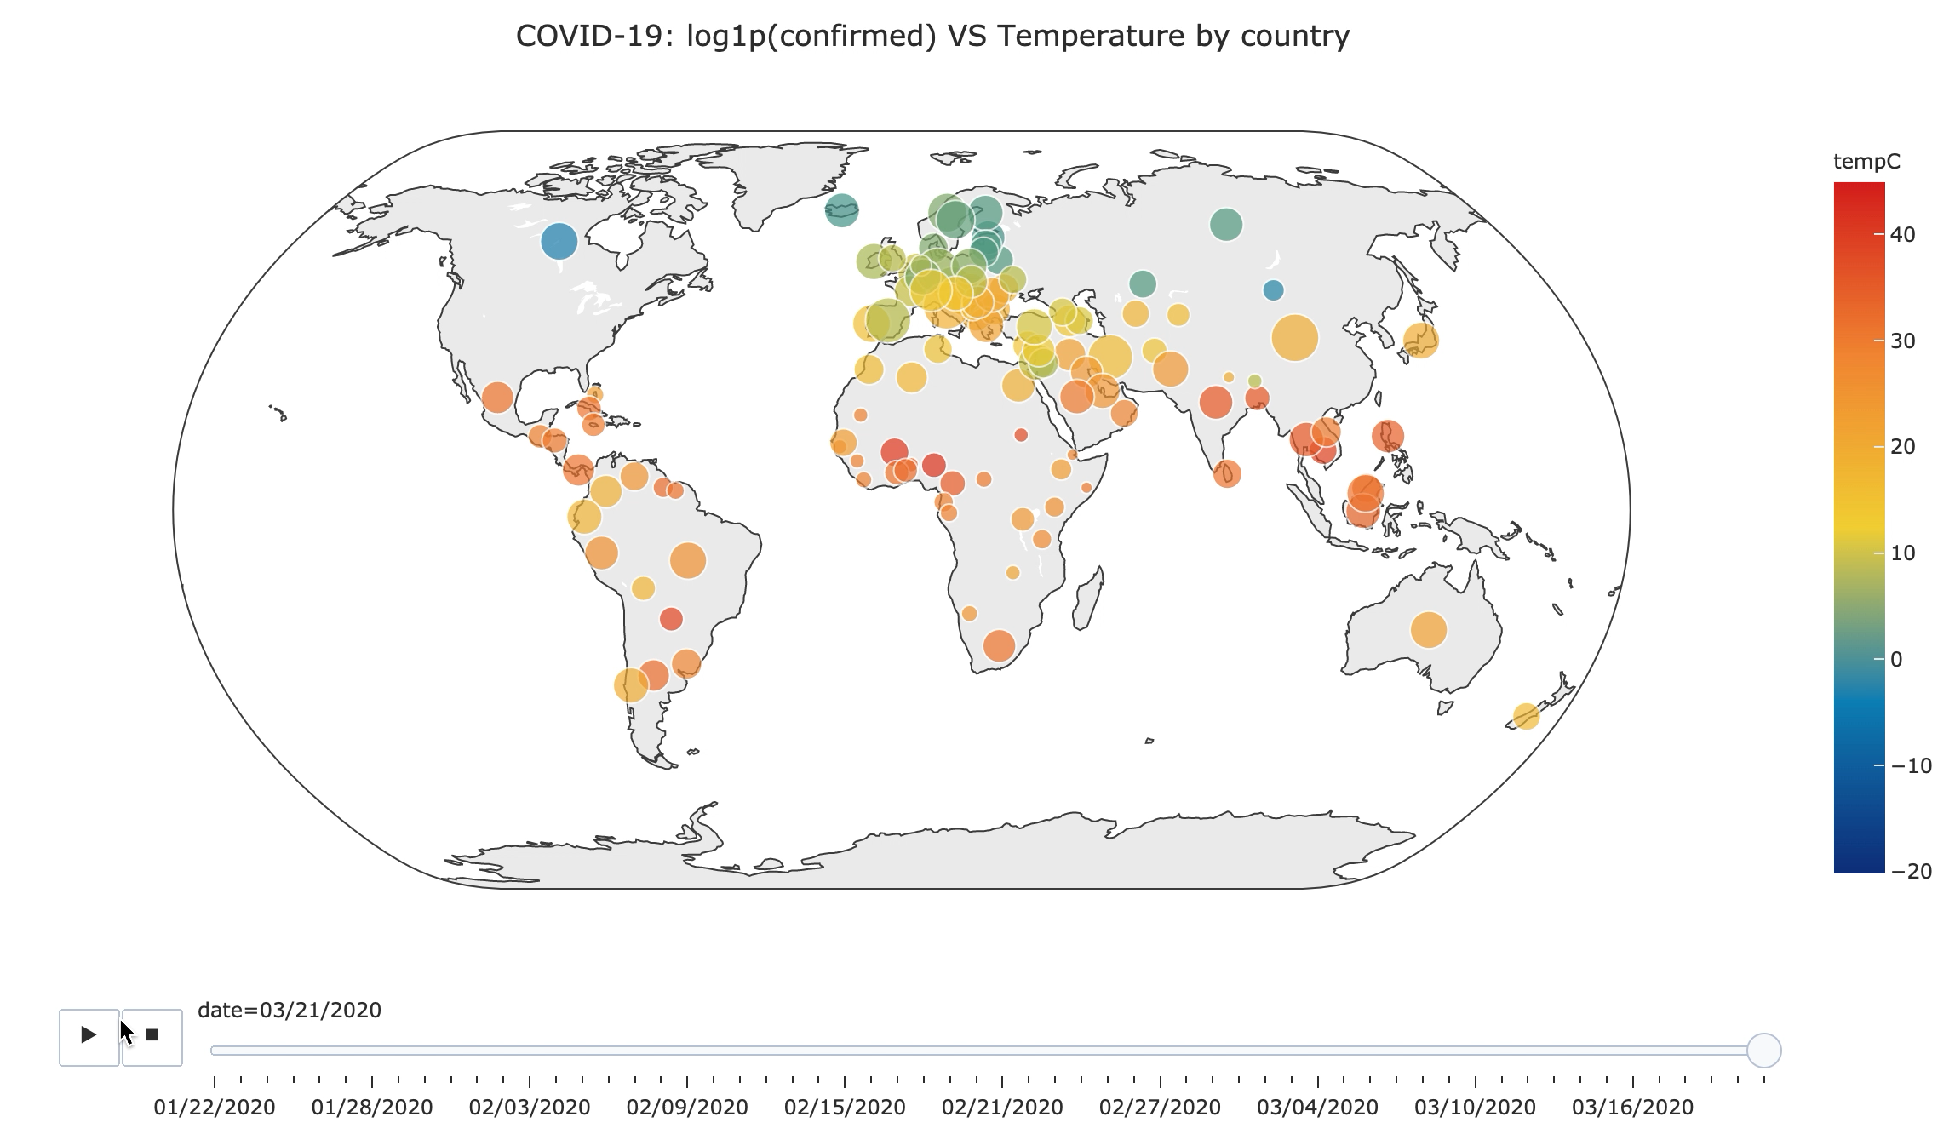
Notes:
The colour of the bubbles represents the temperature. Being red the highest and blue the lowest. The size of the bubble represent the number of cases of COV-19.

Slide 22
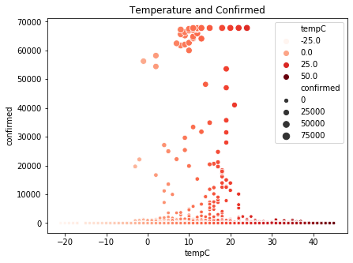
Although the spread of COVID-19 is across all the temperature range,
The temperature range -4 /17ºC has the highest number of confirmed case count.

Slide 23
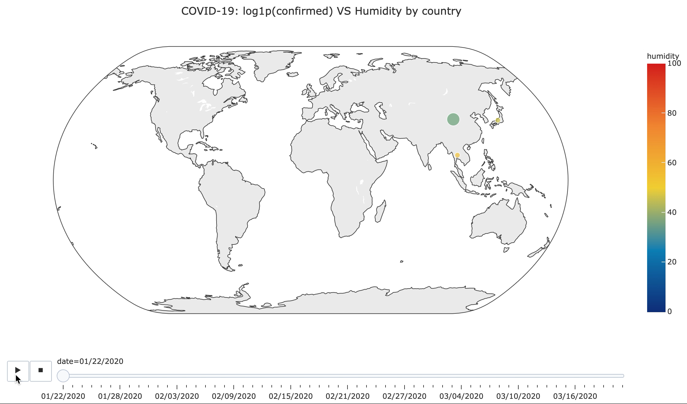

Slide 24
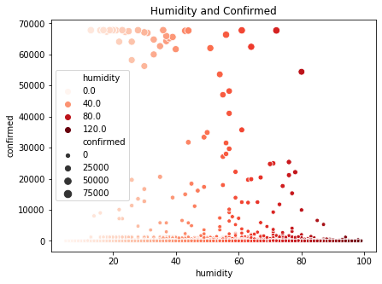
There’s no correlation between humidity and COVID-19 spread.

Slide 25
Predictions
Prediction of the COVID-19 trend using a mathematical epidemic model

Slide 26
Used SEIR model:
Parameters used in the model:
R_t : reproduction number at time t. Typical 3.6 at t=0
T_inc : average incubation period. Typical 5.2 days
T_inf : average infectious period. Typical 2.9 days.
Cfr : case fatality rate
Susceptible
Exposed
Infected
Recovered/ Deceased
Notes:
Using a mathematical epidemic model called SEIR. cuyas siglas hacen referencia a las tres curvas o grupos de población implicados en una epidemia: los susceptibles (S) de contraer la enfermedad, los expuestos (e), los infectados (I) y los recuperados (R).
“Una cuestión relevante es el valor de los parámetros que incluimos en las ecuaciones diferenciales, porque en una epidemia nueva como esta no los conocemos a priori y los vamos a ir estimando”, apunta De León, quien subraya la importancia de uno de los parámetros: R0, que indica el promedio de infecciones que causa un individuo contagiado.
“Lo ideal es que esté por debajo de 1 porque así, la epidemia irá desapareciendo por si sola –dice la matemática–.
Exposed: aquellas personas que incuban el virus sin mostrar síntomas.

Slide 27
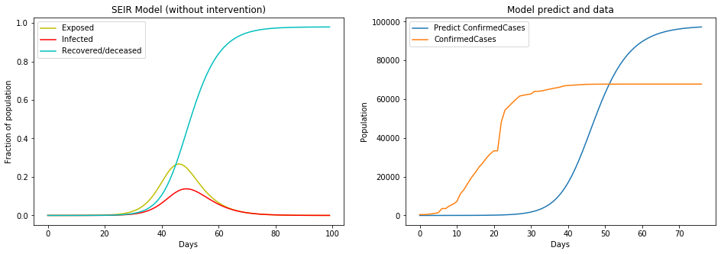
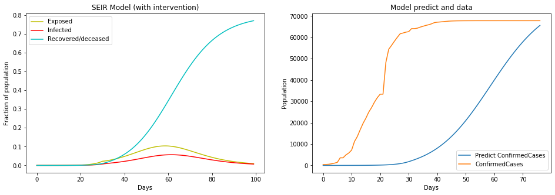
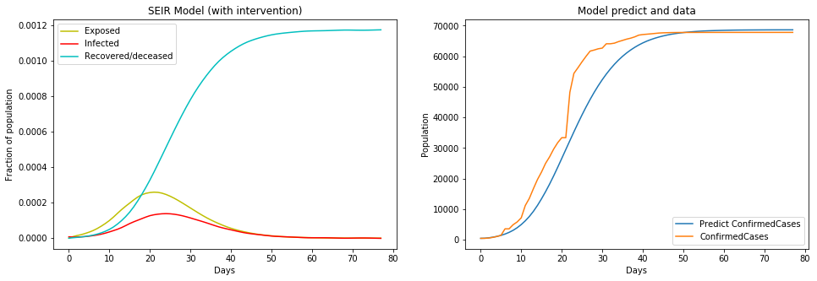
We can see the impact of the intervention, with the reduction on the rate at which new cases occur.

Slide 28
The predictions with the intervention are more accurate

Slide 29
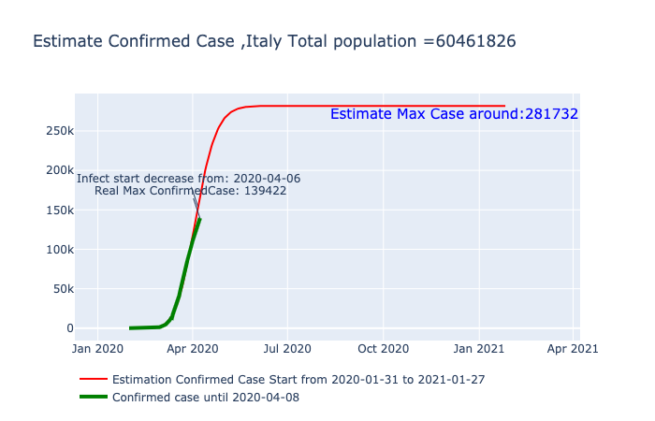
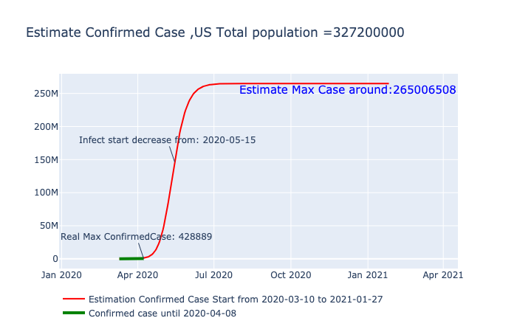
Italy has already arrived at its inflection point but the US still has a long way
Notes:
https://www.agenciasinc.es/Reportajes/Un-modelo-un-teorema-y-teoria-de-juegos-contra-el-coronavirus
Italy prediction may be more accurate because we have more data.

Slide 30
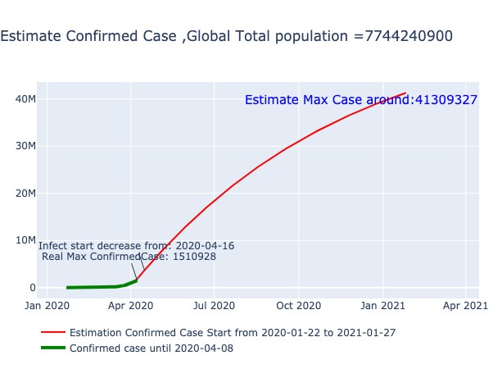
Globally we are in the inflection point, it looks like the growth rate is decreasing

Slide 31
Impact on Economy
How the COVID-19 is affecting the global stock markets?

Slide 32
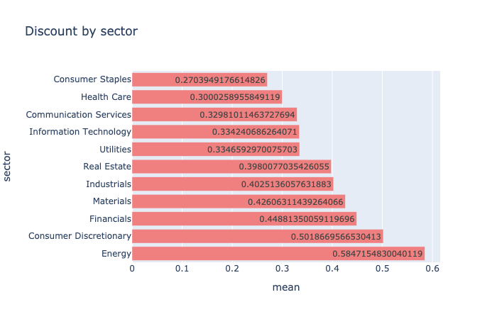
The Energy sector on average has the highest discounted stocks of about 59% .
Whereas Health Care and Consumer Staples have only gone down 28% in comparison

Slide 33
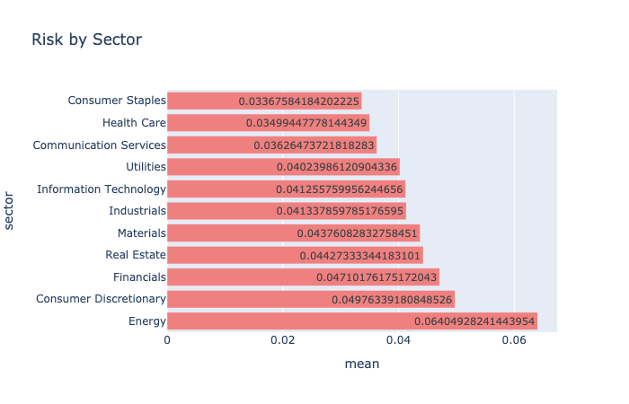
At-risk industries such as Energy (6.38%) and Consumer Discretionary (5%) have high volatility.
Whereas in Consumer Staples and HealthCare is lower (3.36%).
Notes:
Similar to the trend in discounts, it can be seen that at-risk industries such as Energy and Consumer Discretionary have high volatility whereas the volatility in Consumer Staples and Health Care is lower. The Energy sector on average has a variation of 6.38% and Consumer Staples, on the other hand, has an average variation of 3.36%

Slide 34
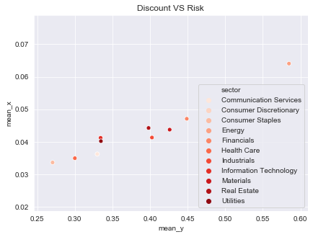
There is a high correlation between discounts and risk.
The sectors at a massive discount (Energy) is also having a higher risk
Notes:
It is interesting to note that there is a high correlation between discounts and risk. The sectors at a massive discount (i.e. Energy) is also having a higher risk.
objective of this analysis is to look at these highly discounted stocks and pick the ones with lower risk.

Slide 35
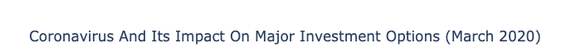
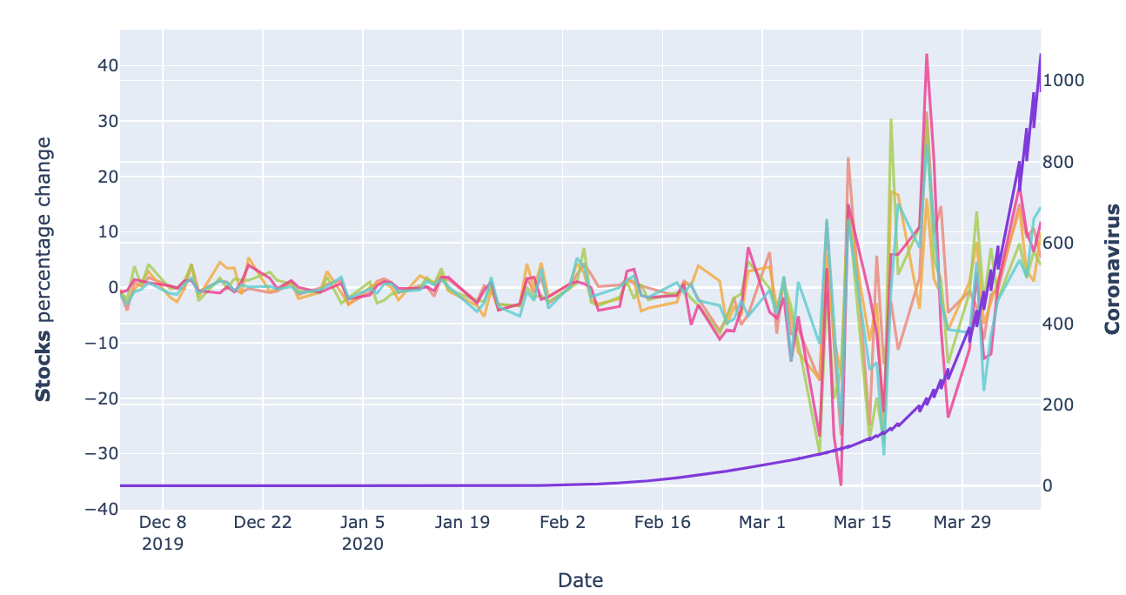
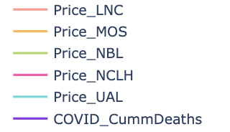
It is not surprising that March 2020 has the greatest number of drops.
Half of the companies experienced their lowest return on 16th March.
Notes:
Took daily stock prices from the 1st of December, 2019 to current date. There wasn’t any specific reason to choose the specified date, the idea was to capture enough historical data to understand what was happening before the crash.
For this analysis, I used the percentage change in the price of the stock.
It is not surprising that March 2020 has the most number of drops. Companies experiences their lowest return.

Slide 36
Conclusions:
COVID-19 is the fastest-killing outbreak of the century, reaching 10K deaths 3 times faster.
Cases are happening in all the age groups. But the age group of 70 to 90 have a higher mortality rate.
At the current rate, there are signs of a drop in the total cases.
The temperature range -4/17ºC has the highest number of confirmed case count.
The stock market is unstable, experiencing the lowest returns.

